Slide 1
States of Matter

Slide 2
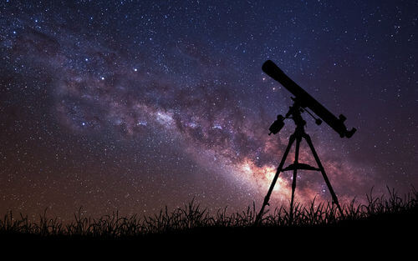
There are three states in which matter can exist.
All matter in the universe is a solid, liquid or gas.

Slide 3

By the end of this Smart Lesson, you should be able to:
Visually identify whether matter is in a solid, liquid or gaseous state.
Describe how the shape and volume of matter can be definite or variable depending on it's state.

Slide 4
Matter has different properties depending which state it's in.
Two key properties are shape and volume.
In certain states, these properties are definite: unable to change.
In other states, these properties are variable: able to change.

Slide 5

Solids have a definite shape and volume.
This means that, regardless of what container they are in, they:
have the same shape, and
occupy the same area.

Slide 6
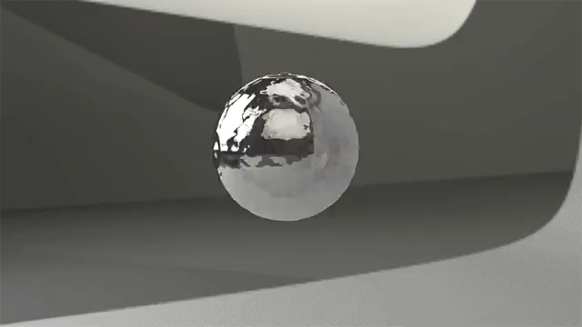
Liquids have a variable shape but definite volume.
This means they will change their shape to fit different containers.
However, they will still occupy the same amount of space.

Slide 7
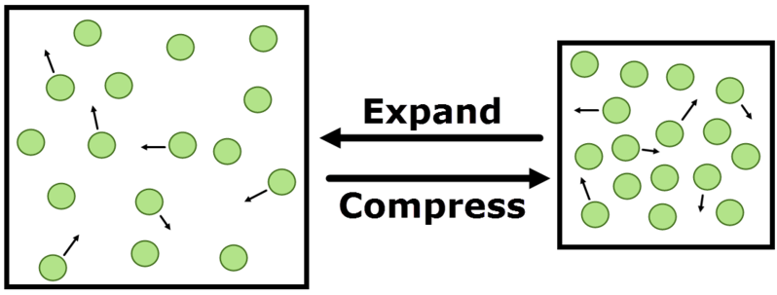
Gases have variable shape and volume.
This means they will change their shape and the space they occupy to fill a container.
Gases will expand (grow) when moved to a larger container and compress (shrink) when moved to a smaller container.
They are thus expandable and compressible.

Slide 8

Watch this video (1:17) to review the properties of the three states of matter!

